Slide 1
The MRMC Experience:
ED Initiatives to Reduce Opioid Rx Rates
Jeffrey Hopkins, MD, FACEP
Chair, Department of Emergency Medicine
Milford Regional Medical Center
2018 Patient Safety Forum
Massachusetts Coalition for the Prevention of Medical Errors
May 4, 2018

Slide 2
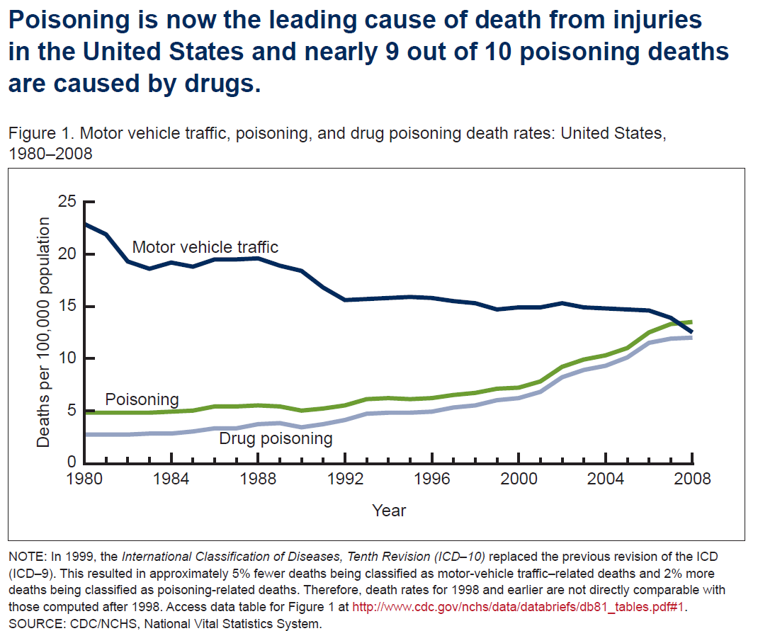

Slide 3
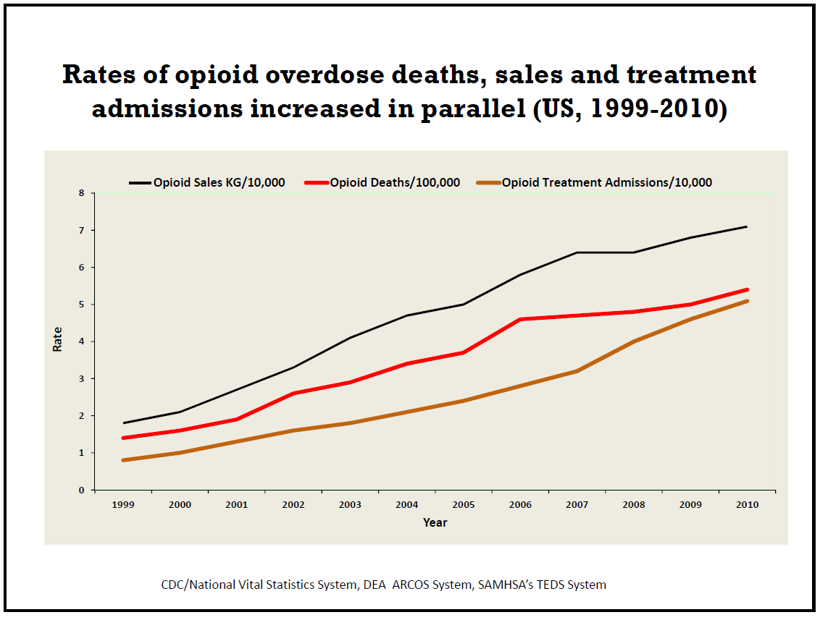

Slide 4
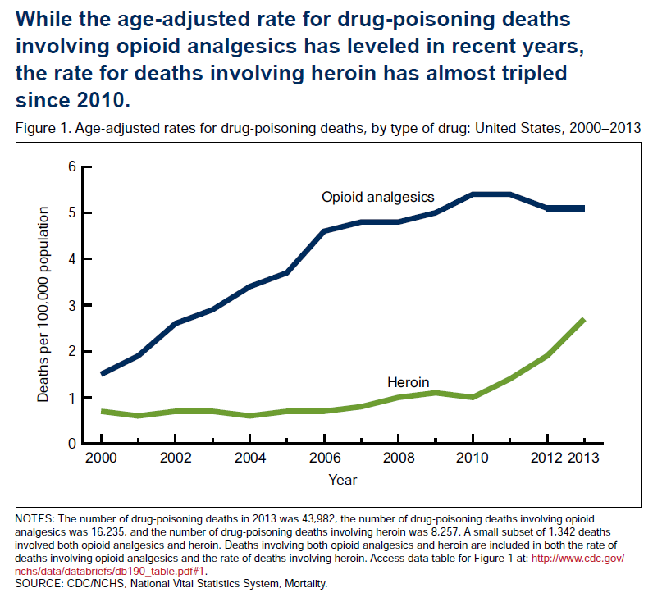

Slide 5

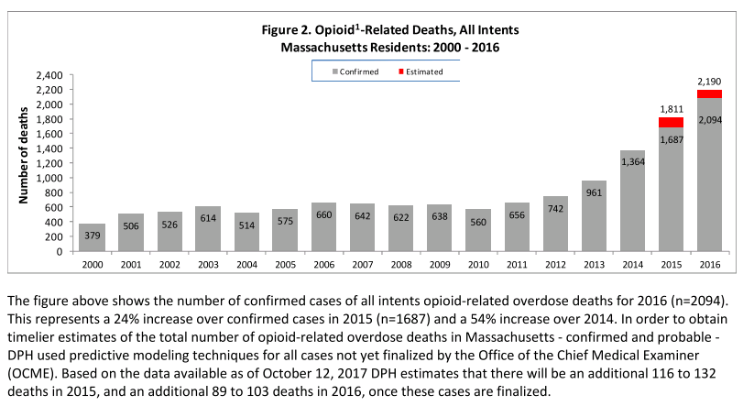

Slide 6
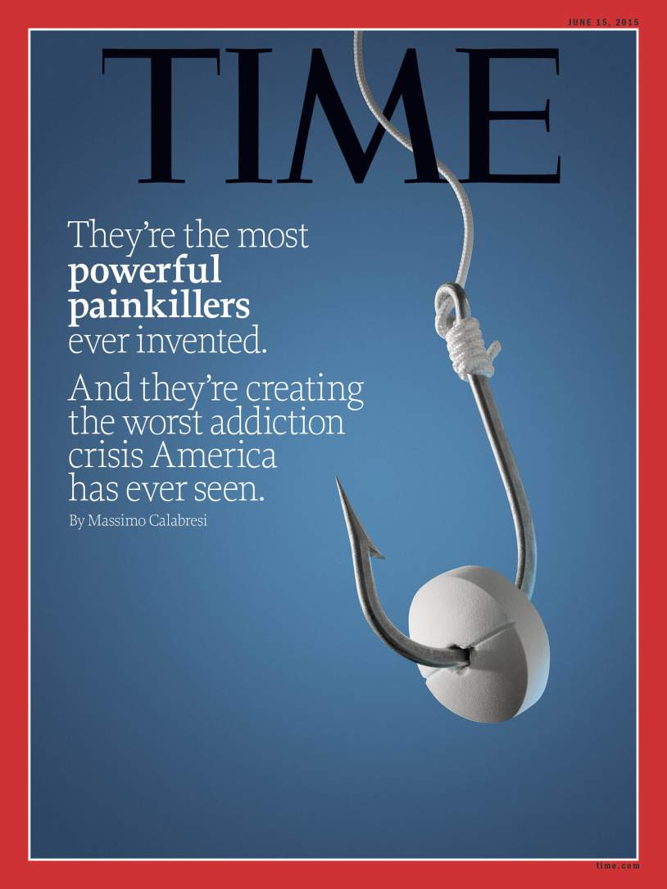
How did we get here?

Slide 7
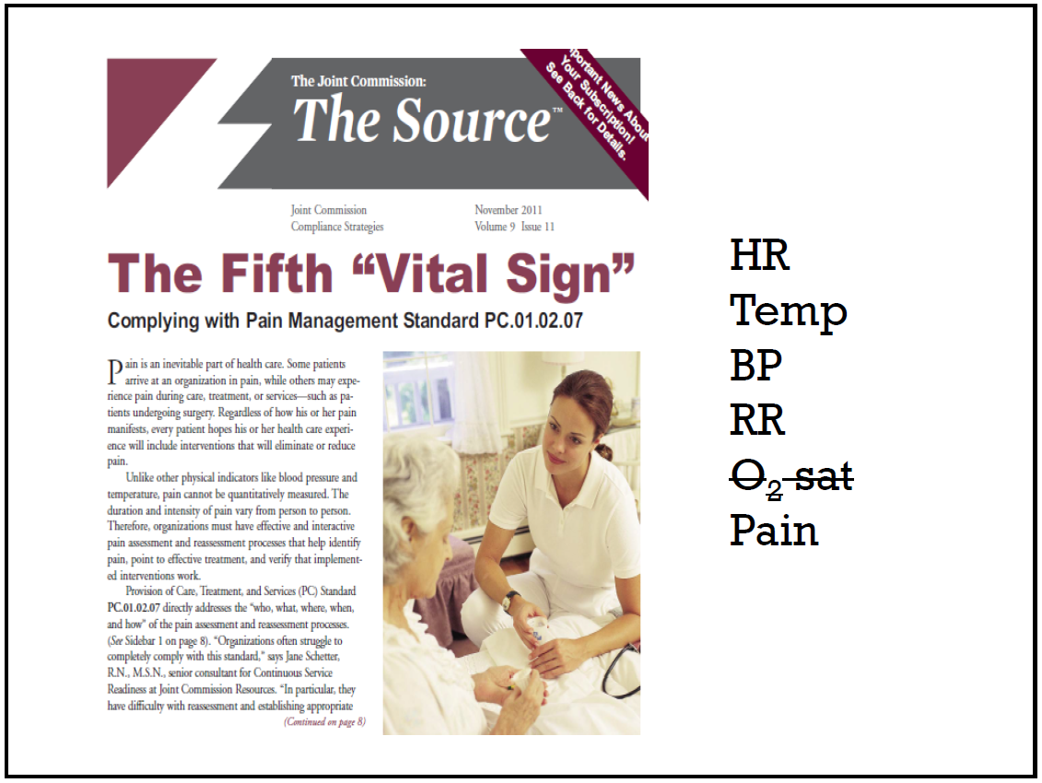
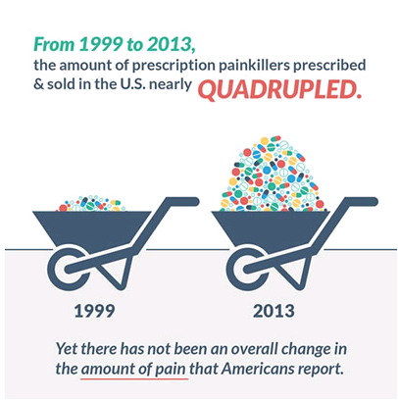

Slide 8
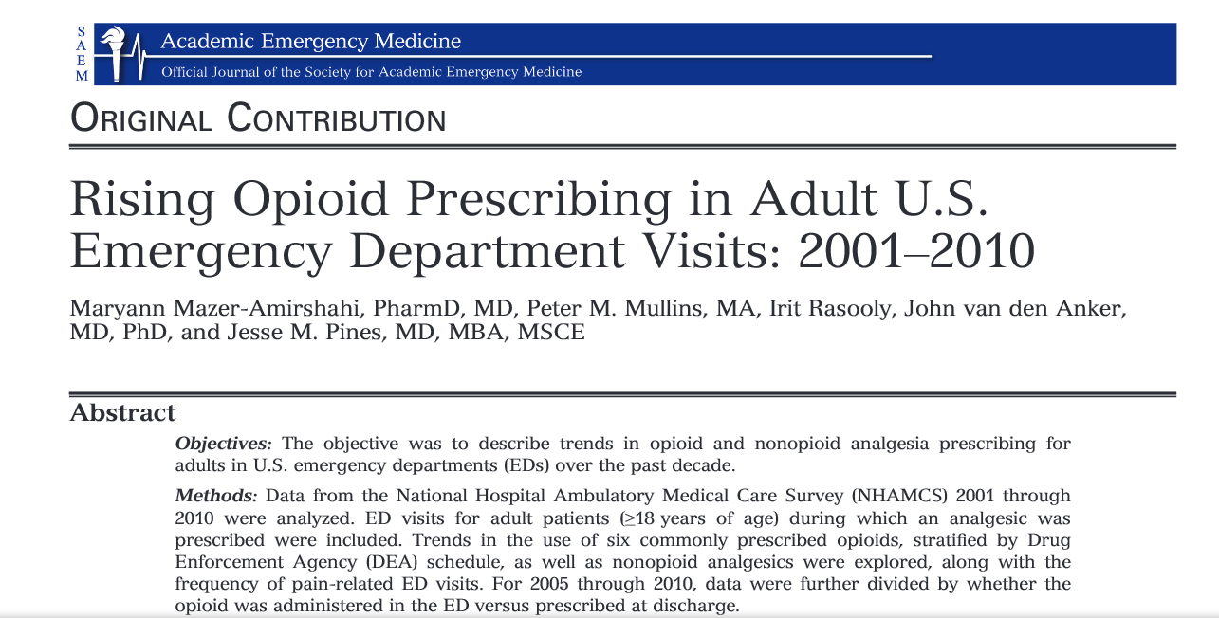
% of ED Visits Resulting in Opioid Prescription:
  2001: 20.8% → 2010: 31%

Slide 9

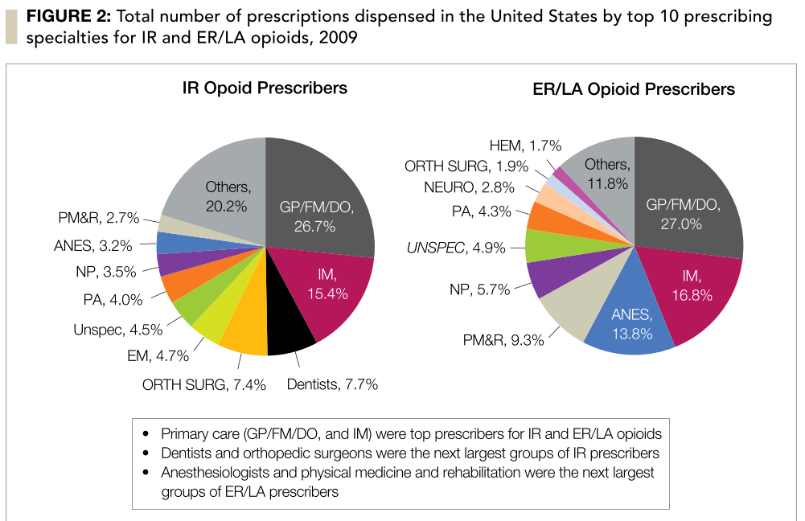
Perspective from
Emergency
Medicine

Slide 10

½ of patients arrive to ED with painful conditions
17-35% discharged ED patients receive Opioid Rx
Median # of pills/Rx = 15
99% Opioids from ED are Immediate Release
Emergency Department providers account for <5% of all opioid Rx written and ~ 1.5% of all opioid pills in the U.S.

Slide 11
MRMC ED
MACEP
BI Opioid Rx Study
Pain Management Committee
MHA
OPPE Feedback
State Regulations
Substance Abuse Task Force

Slide 12

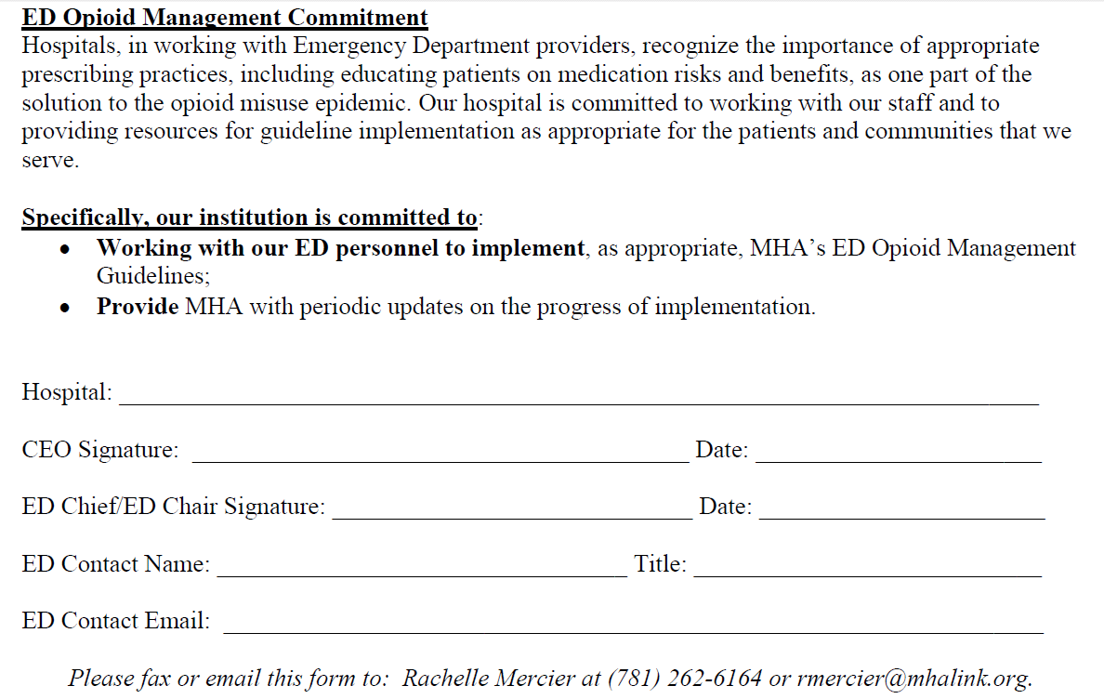
MHA Guidelines (2015)
1) Screening:
  SBIRT
2) Use of PMP
3) Health Info Exchange (HIE)
  PreManage ED
4) No Lost/Stolen Rx Refills
5) Counseling of Use/Storage
6) 5 day limit from ED

Slide 13
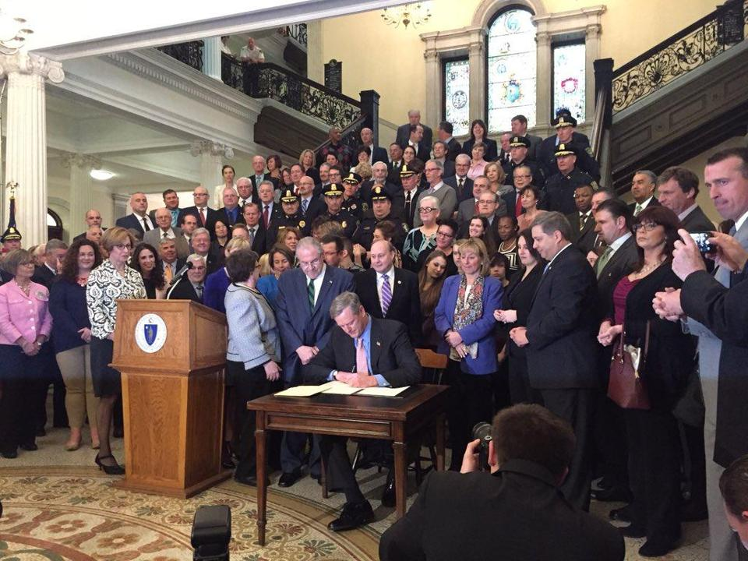
CHAPTER 52, ACTS OF 2016:
AN ACT RELATIVE TO SUBSTANCE USE TREATMENT, EDUCATION AND PREVENTION

Slide 14
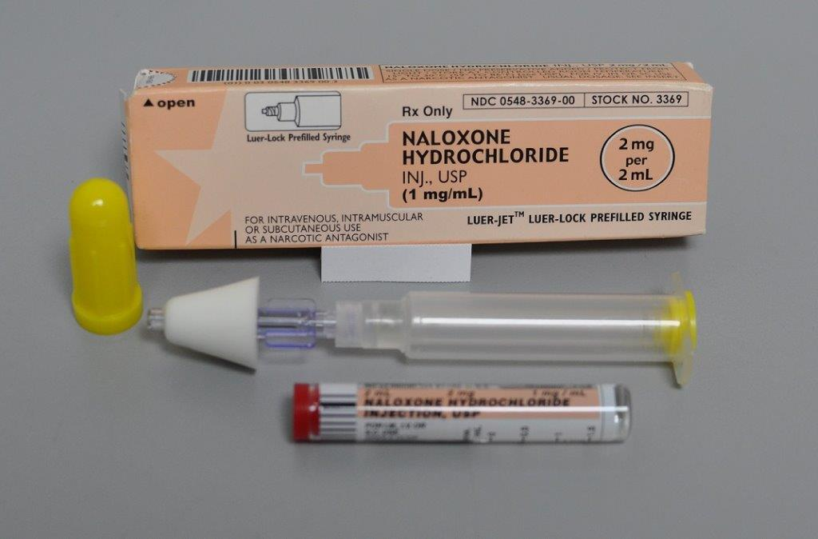
Gov. Baker’s “Opioid Bill” 2016
7 day Restriction (1st time Opioid Rx)
Partial Fill Option
Mandatory Use of PMP (10/15/16)
SUDE Evals for OD/Narcan patients in ED
Narcan Accessibility

Slide 15
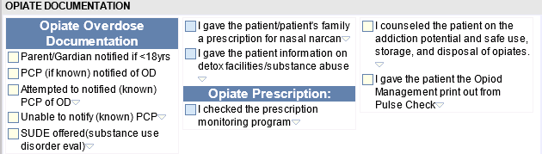
MRMC Initiatives in the ED
PMP → MassPAT Use by Entire Group
Dept Mtg: Quality Focus
  Regular Opioid Updates & Team Feedback
Overdose, Narcan & SUDE Audits
EMR Prompts/Updates

Slide 16
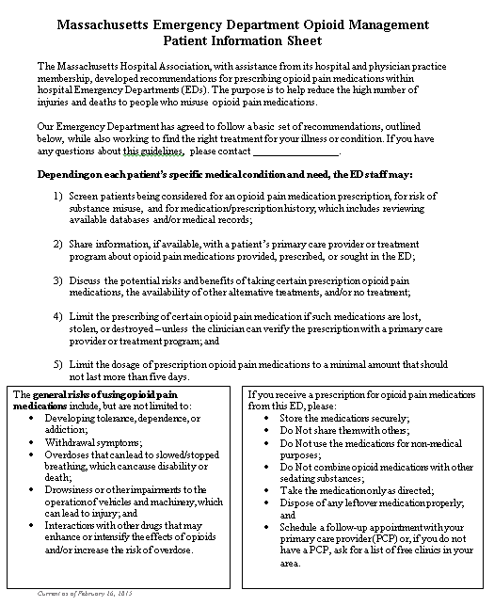
Customized
MHA Patient Info Sheets

Slide 17
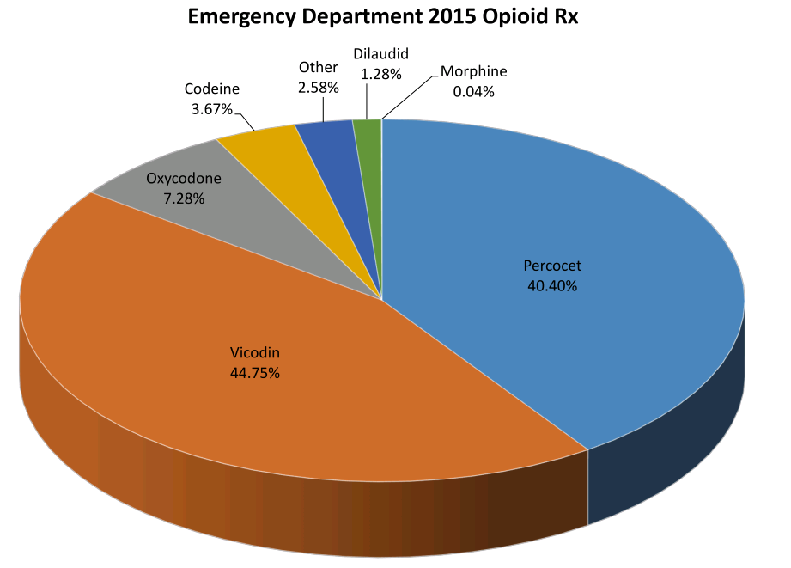
BASELINE ED DATA (2014-16)
Substance Abuse Task Force
Educational Sessions
  Dept Mtg
  MACEP
  MHA
OPPE Datapoints
Group Feedback
  Types of Opioid Rx
  % of D/C Pts with Opioid Rx

Slide 18
“Reduction in Opioid Prescribing through Sharing of Individual Provider Prescribing Practices: A Multicenter Study”Boyle, Smulowitz, et al.
One of 10 Hospitals in MA (5 AMCs/5 Community EDs)
Goal #1:
  Determine Extent of Opioid Prescribing in EDs in MA
Goal #2:
  Determine Impact of Sharing of Performance Metrics on the Rate of Opioid Prescribing

Slide 19
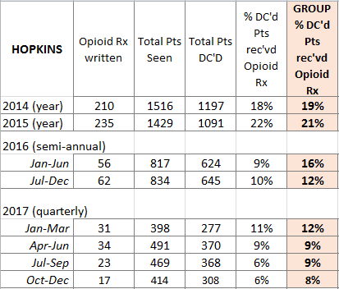
Opioid Rx Reduction Study
Quarterly Data Sharing (Blinded vs. Mean)
DR. X

Slide 20
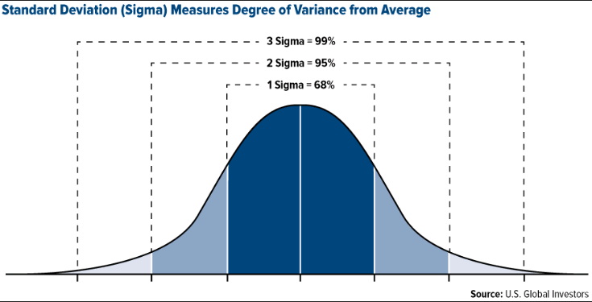
Opioid Rx Reduction Study
Intervention:
  1 Standard Deviation +/- Mean
  Standardized Email
  Direct Communication

Slide 21
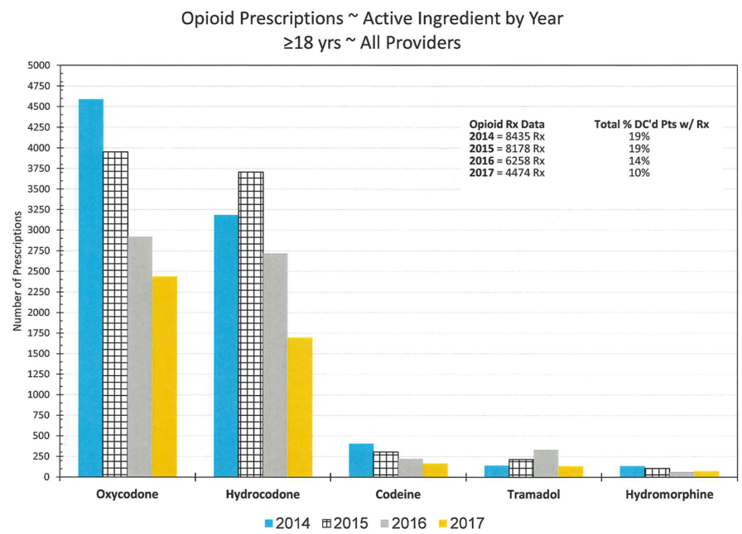
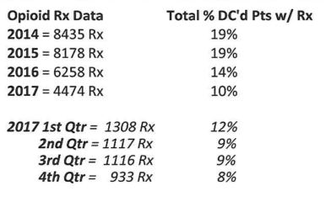

Slide 22
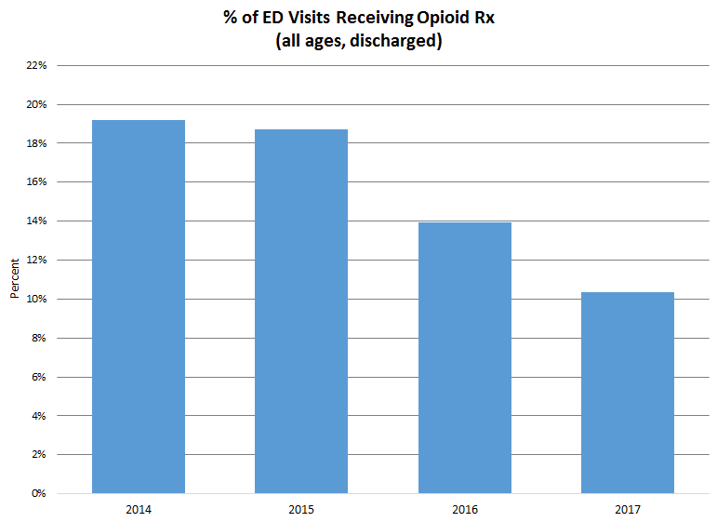
RESULTS (2014→2017)

Slide 23
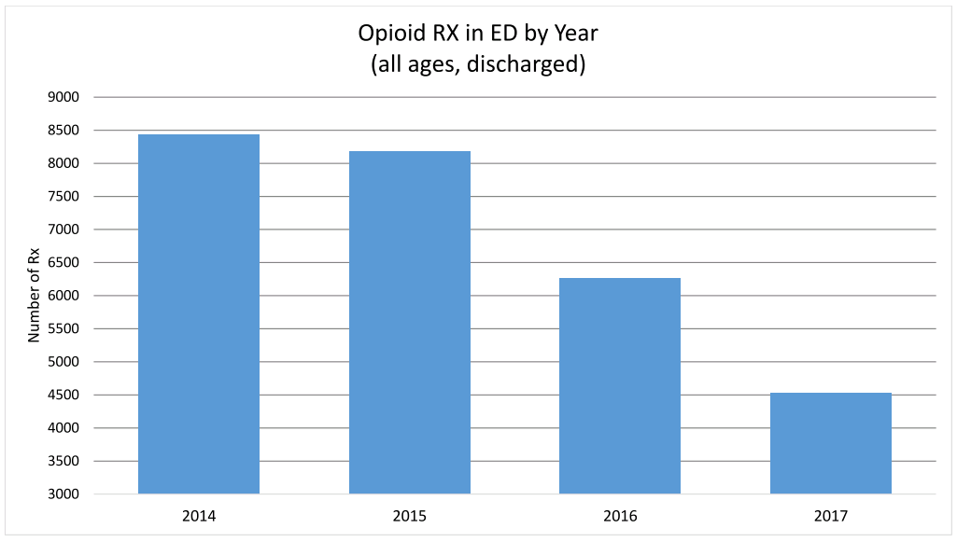
RESULTS (2014→2017)

Slide 24
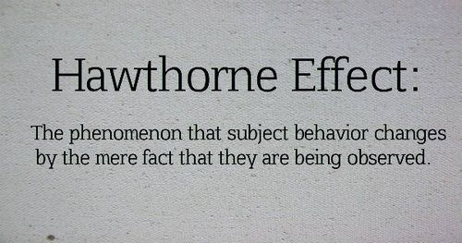




Slide 25

Next Steps…
Continued Monitoring of Opioid Rx Rates
Continued Regular Departmental Feedback
  Department Meeting Quality Focus
  Educational Updates
Continued Hospital-Wide Education
  Malpractice Insurer Offering Educational Sessions
  Grand Rounds
CARE Act 2018
  MACEP/MHA/MMS
Pain Management Committee
Opportunity for Blinded Feedback Tool Use in other Areas?

Slide 26

jhopkins@milreg.org
Special Thanks to Scott Weiner, MD, Peter Smulowitz, MD, Katie Boyle, MD (MACEP) & Stephen Anderson, MD (WACEP)

